Slide 1
Pre Built Web Templets
What are they?

Slide 2
Pre Built Templets
-They are used for quick launch of web apps.
-Sometimes called quick start templets.
-You can create you own templet.

Slide 3
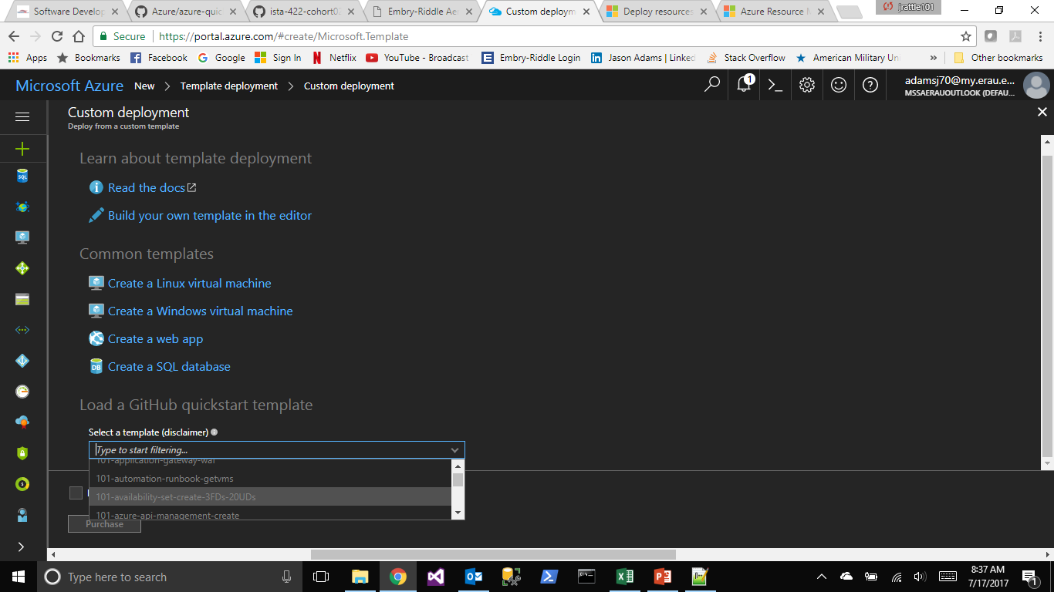
Choosing a templet

Slide 4
Choosing a templet
-You can choose from over 100 prebuilt templets
-You can download more templets from the web

Slide 5
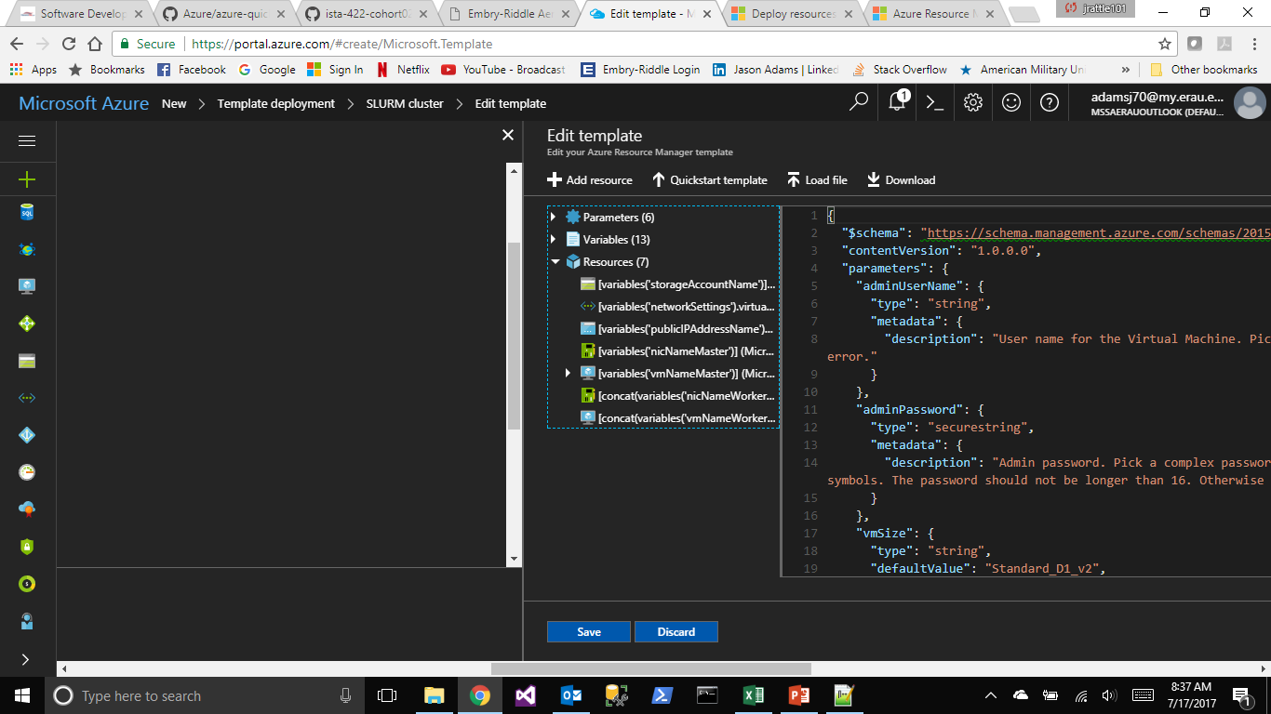
Editing templets

Slide 6
Editing templets
-You can start from scratch and build the website how you want
-Can edit from existing templet to customize the web app
-It allows for rapid redeployment of web sites.

Slide 7
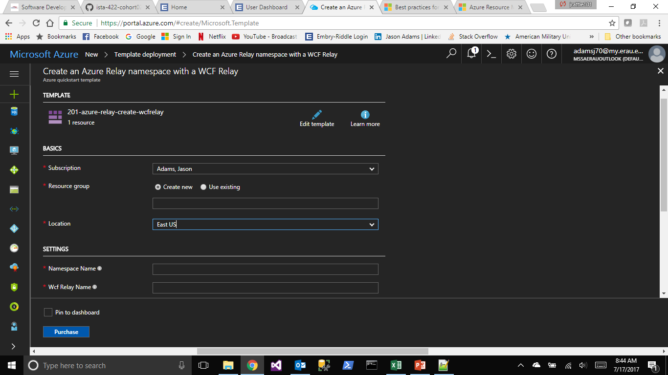
Deploying templets

Slide 8
Summary
-Easy to setup
-Fast
-Customizable

